Slide 1

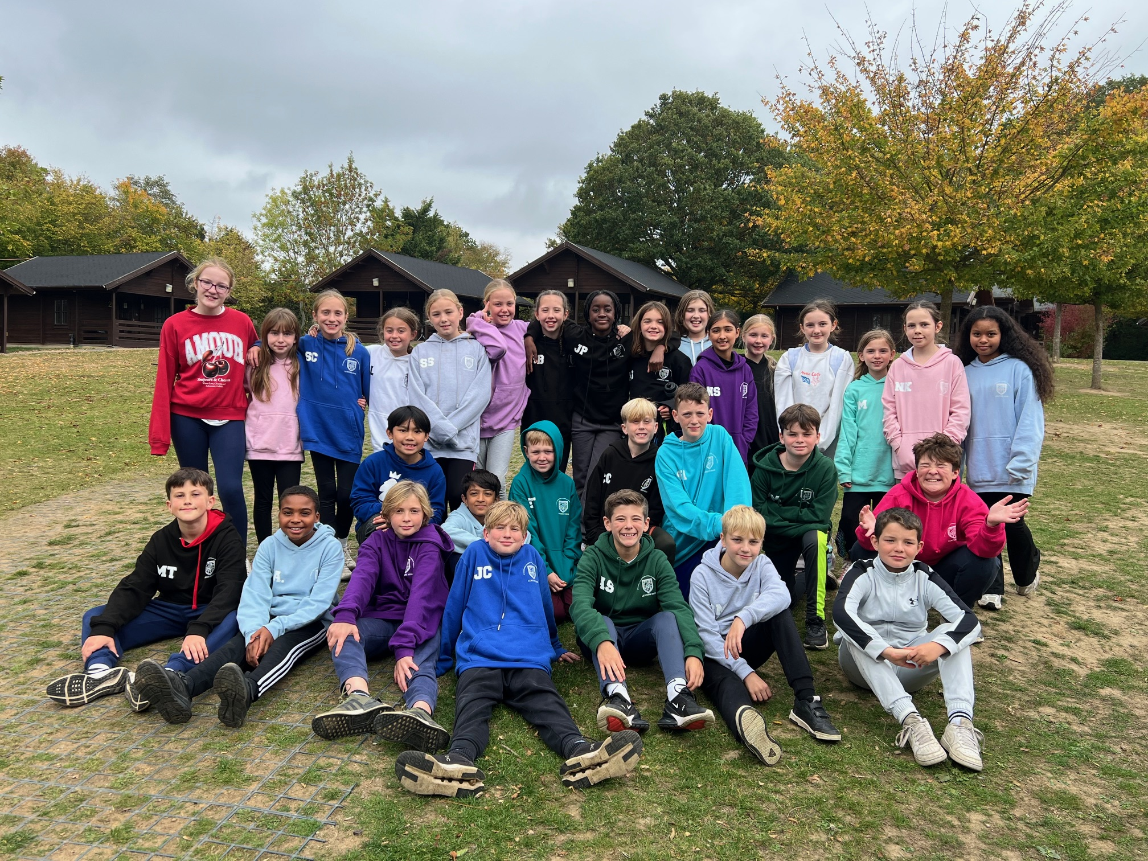
Class 6
Danbury Residential Trip
5th – 7th October 2026
An exciting adventure awaits in the great outdoors!

Slide 2
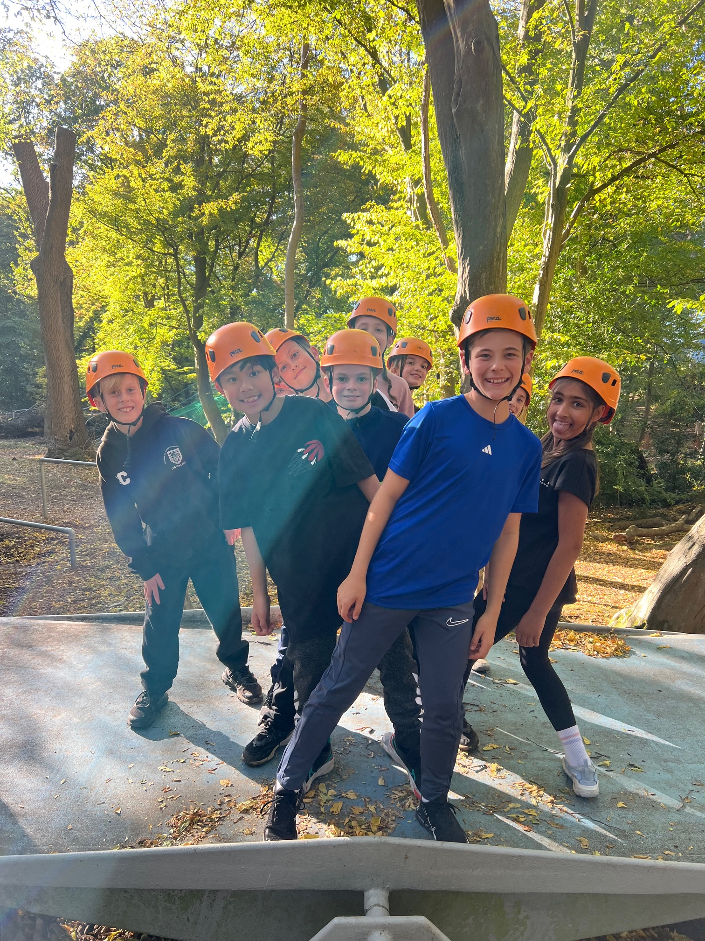
Why Danbury Outdoors?
Building skills: Step outside their comfort zone to grow together.
Achieving goals:
Confidence: Challenge themselves to try new things.
Teamwork: Solve problems and support each other.
Independence: Manage their belongings and daily routine.
New Experiences: Discover talents and make lasting memories.

Slide 3
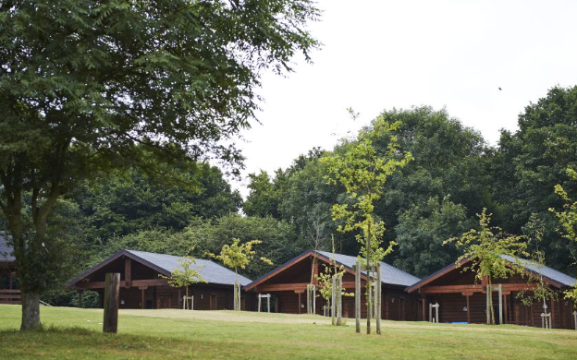
Where We Will Be Staying
A Home in the Woods
We will be staying in cosy cabins and lodges nestled right in the heart of the Danbury forest! These are safe, warm, and built for a proper adventure.
Choosing Cabin-Mates
One of the best parts is sharing a space with their friends.

Slide 4
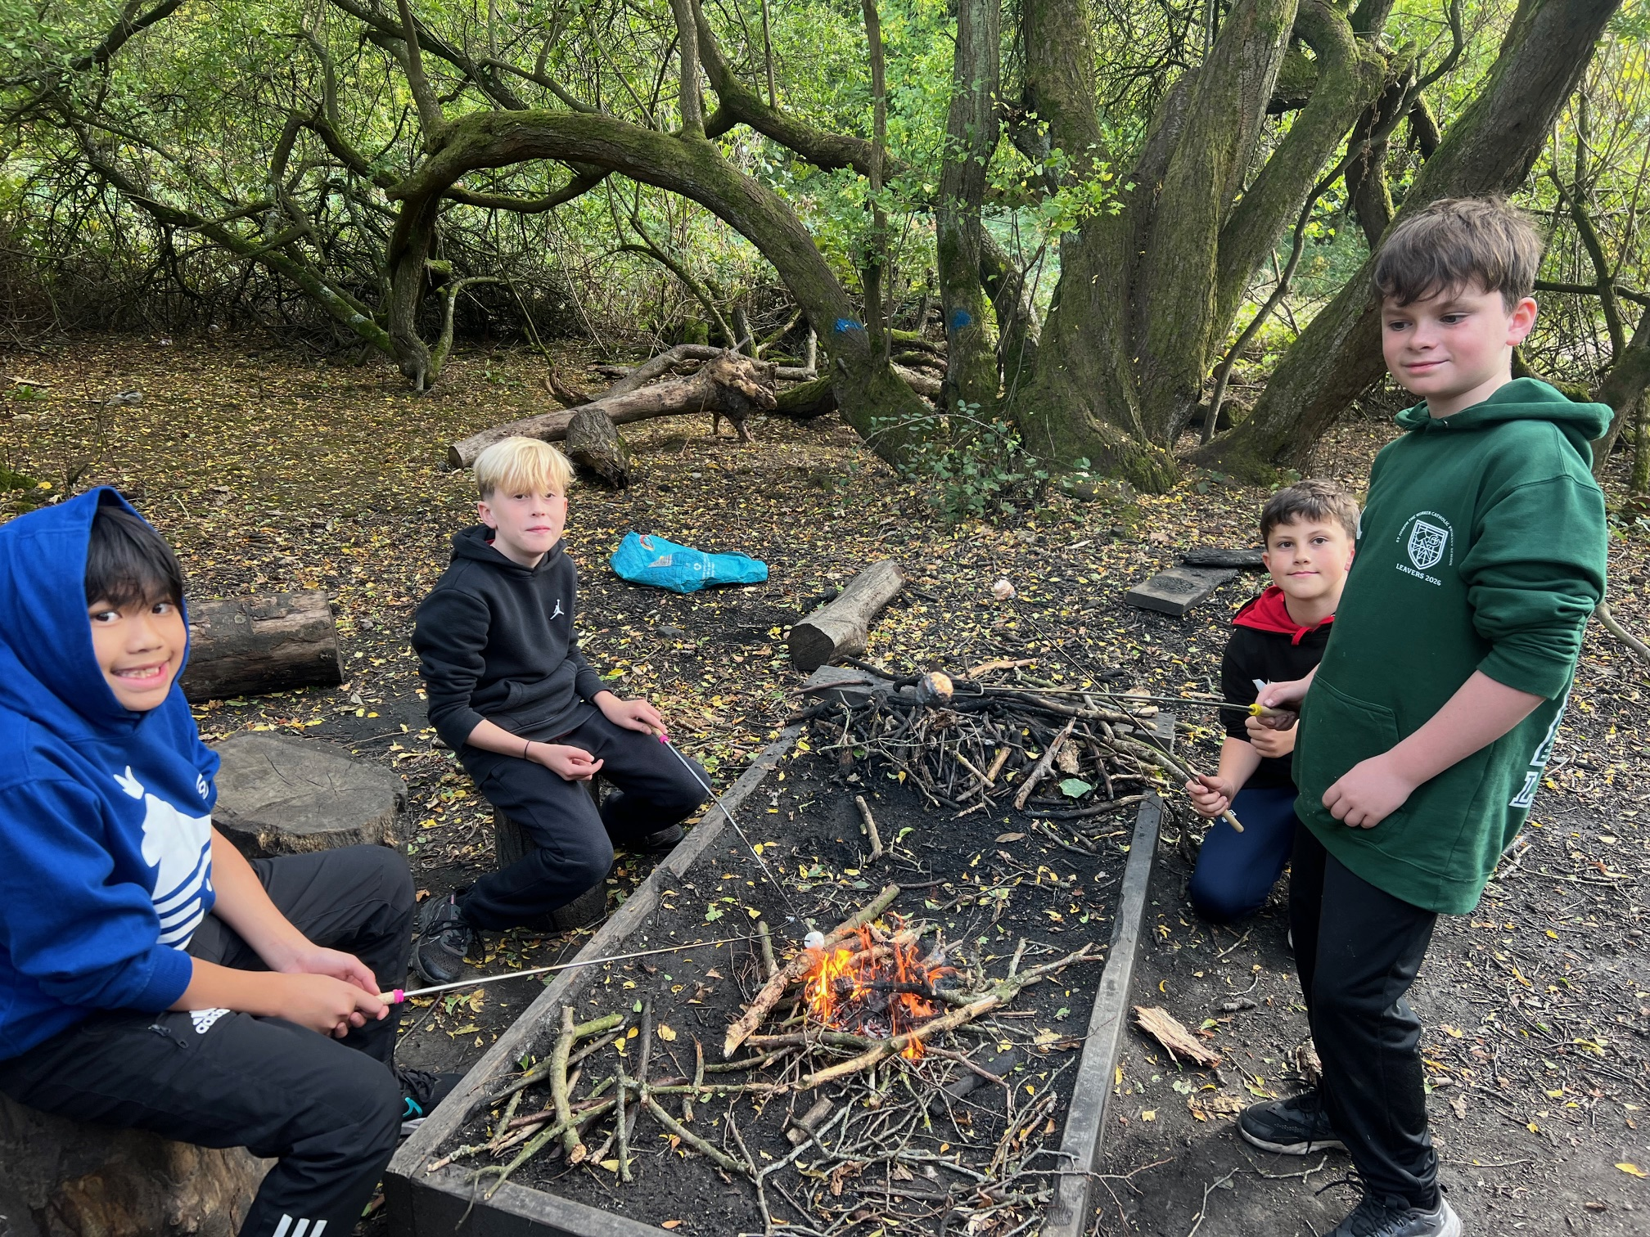
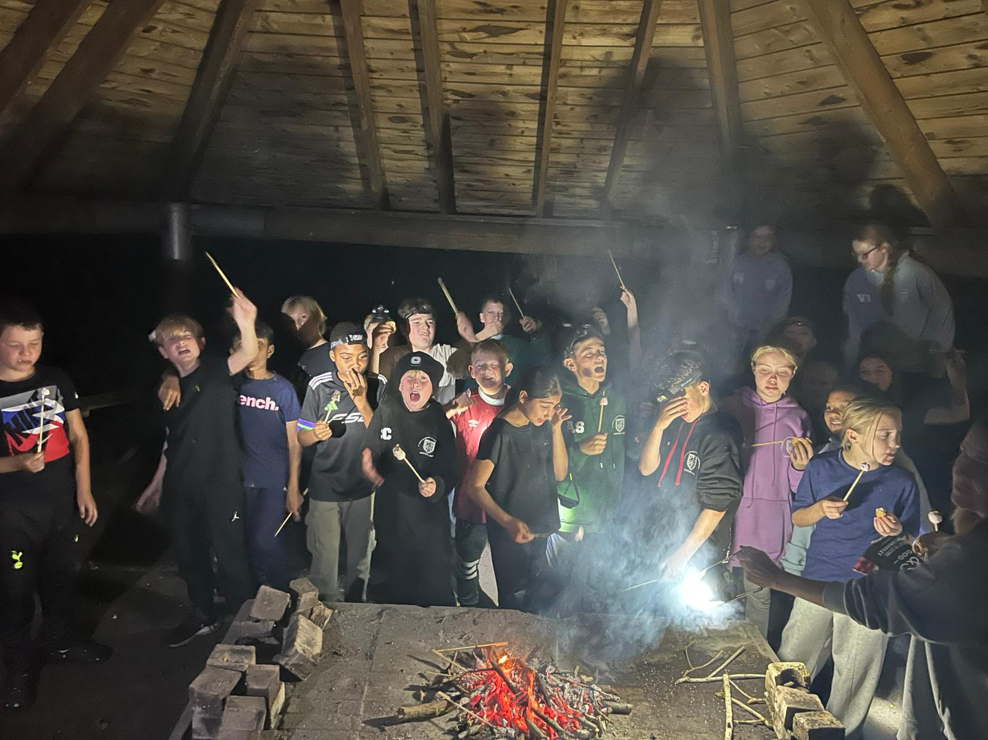
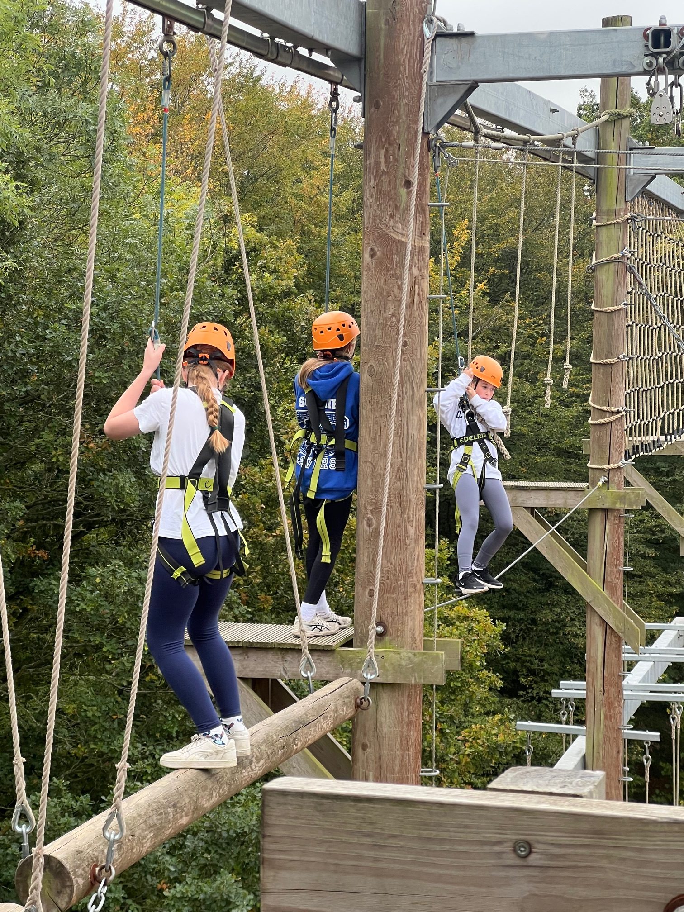
Action-Packed Activities
1
2
3
Evening Fun
Evening Fun: Enjoy a night walk and sing songs by the campfire.
Forest Skills
Learn bushcraft, explore caves, and navigate woods.
High Adventures
Conquer the rock wall, high ropes, zip wire, and BMX track.

Slide 5

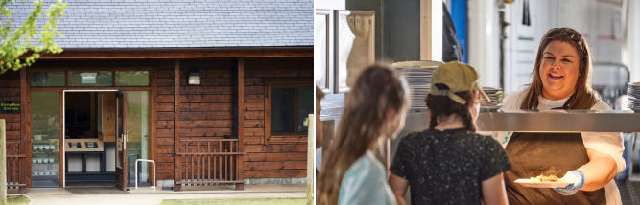
Fuel for Adventures
There is a child-friendly menu with breakfast, lunch, and dinner. There are always plenty of snacks and fruit to keep the children going between activities.
We cater to all dietary needs. Whether vegetarian, gluten-free, or nut-free, we ensure safe meals.

Slide 6
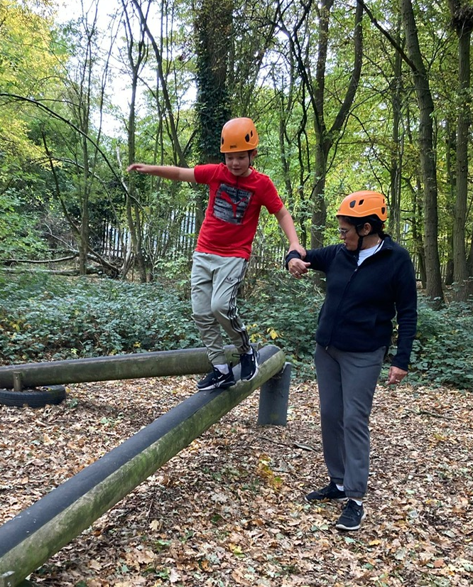
Care and Support
Wellbeing is Priority
Our staff support pupils 24/7. Whether children need help with a scraped knee, regular medication or just a bit of encouragement, we are ready.
Information for Parents
Medication: Staff safely manage all medication.
Special Needs: We cater to all needs; note them on medical forms.

Slide 7

What to bring
Children to bring suitable clothes for sports activities
2 x trainers
1 x Crocs/sliders/flip flops
Waterproof jacket
Underwear, socks etc
Nightwear
Wash kit (no sprays please)
A towel
Sunhat and sun cream
Named plastic bottle with a secure lid for daily drinks.
2 x plastic bin bags
Packed lunch for Monday (no fizzy drink or chocolate please) in a plastic bag.
Sleeping bag
Pillow
Torch or head torch
What to leave behind
Electronic devices
Straighteners
Expensive items/jewellery
Cameras

Slide 8
Our Trip Itinerary
Tuesday 6th October
Full Action
A full cycle of climbing, caving, BMX, and forest exploration from dawn til dusk.
Monday 5th October
Departure
9.30am arrive at school via the front entrance. 10.45am coach leaves school. 1pm start activities!
Wednesday 7th October
Activities & Farewell
Morning activities, a final lunch,and heading back by afternoon. 2pm pick up at Hutton Poplars

Slide 9

Any Questions?

