Slide 1

Phonics Screening Check
March 12th 2026

Slide 2
What is the Phonics Screening Check?
The Phonics Screening Check is an assessment for children.
During the Phonics Screening Check, children are asked to read (decode) 40 words.
  Half of the words are real words and half are pseudo words (alien words).
  Children will be asked to "sound out" a word and blend the sounds together. e.g. f-o-x - fox.
The focus of the check is to see which sounds the children know and whether they can decode at an age-appropriate level.

Slide 3
Dates
The assessment will be delivered in the week commencing June 8th.
The test is completed 1:1 with Miss McElhill and whilst it should only take a few minutes to complete, there is no time limit.
Children are familiar with the layout and structure of the test, having completed it before.

Slide 4
Scoring
The pass mark in recent years has been 32 out of 40.
If children do not pass in Year 1, they will resit the assessment in Summer 2027 (Year 2).

Slide 5
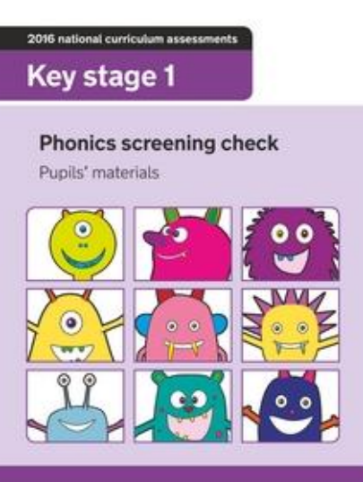
This is an example booklet.

Slide 6
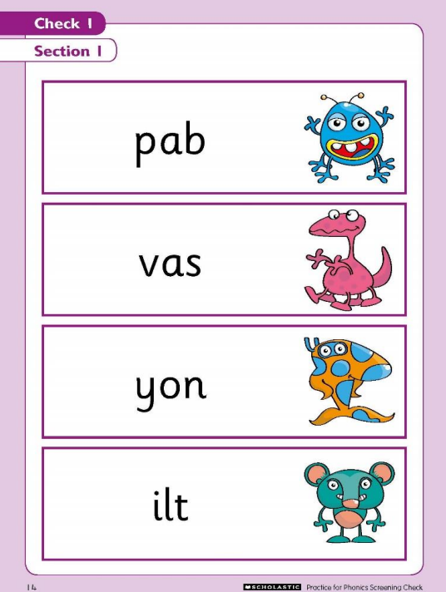
The alien words check a child’s confidence in decoding unfamiliar words.

Slide 7
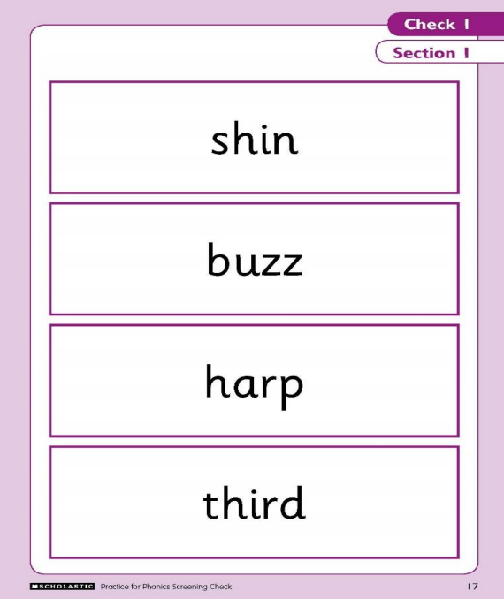

Slide 8
The children have been encouraged to use sound buttons.
This helps with decoding unfamiliar words.

Slide 9
https://www.youtube.com/watch?v=3sSLnqdwgUk&list=PL-yJujglakF9GEuJqcnxE3Xu9Boq17I59&index=4

Slide 10
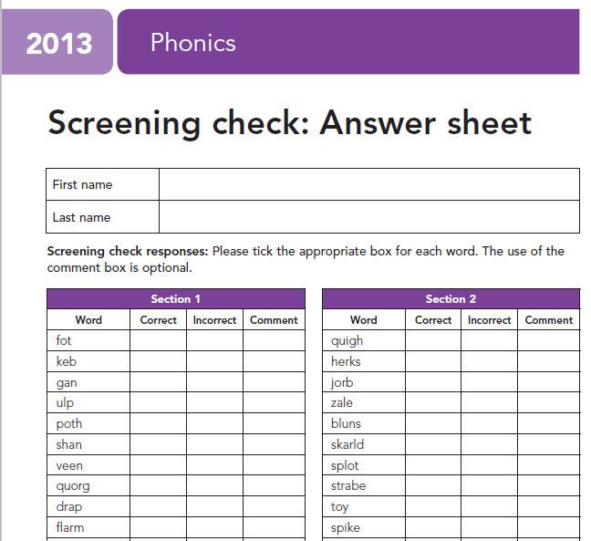


When I am completing the answer sheet, ticks will be used for correct and incorrect answers.

Slide 11
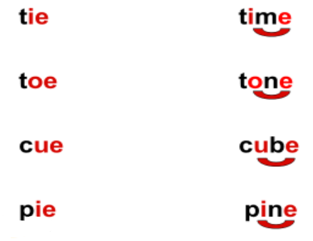
Split digraphs
A split digraph is a digraph that is split by a consonant. Usually a long vowel sound, e.g. ‘a-e’ (cake), ‘i-e’ (five), ‘o-e’ (code), 'e-e' (sphere) and ‘u-e’ (rule).

Slide 12
How can I help at home?
Play lots of sound and listening games with your child e.g. ‘I spy with my little eye something beginning with ‘th’ / the ‘ee’ sound in it…’
Go on www.phonicsplay.co.uk or
https://home.oxfordowl.co.uk/
Listen to pronunciation of sounds: https://www.youtube.com/watch?v=EYx1CyDMZSc
Read as much as possible to and with your child - encourage your child to sound out any words they are unsure of.

Slide 13
Questions?

