Slide 1

Welcome to Class 3!
Class teacher - Ms Corbett
Learning Support Assistant - Mrs Andrews (mornings)

Slide 2


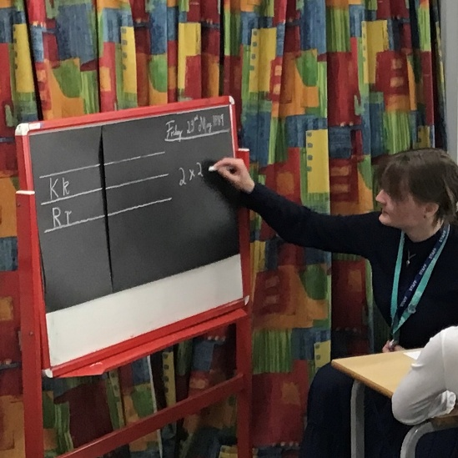



About Me
It’s lovely to meet you all,
I’m Ms Corbett!
I enjoy spending far too long reading every exhibit at museums, singing, hiking (if I’m not the one carrying the bags) and reading the classics.
If you ever need to contact me, you can do so through the office.
However, please do speak to me at the end of the school day if you have any worries or concerns!

Slide 3


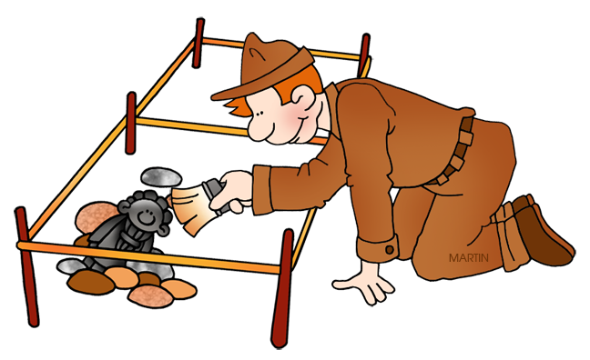
First week back!
This past week the children have been predicting what they think will happen in Michael Foreman’s ‘Seal Surfer’!
They have also been coding their own animated stories in Scratch and thinking like archaeologists in history!

Slide 4

Uniform
Everything named please.
We’ll do our very best to return it to you if we know who it belongs to.
Hair tied back if it is shoulder length – girls and boys.
Hair ribbons and bands should be green, black or white.
Children should not wear black trainers as school shoes.
No nail varnish
No earrings

Slide 5
Timetable
Drop off: Between 8:45am and 9:00am
Pick up: 3:30pm at the side door
PE: Tuesday and Thursday (swimming)

Slide 6

Swimming
Please make sure children have:
A swimming hat (goggles if needed)
Girls: A black swimming costume
Boys: Swimming shorts above the knee
Change of clothes (underwear)
A towel
Raincoats!
Children are to wear their swimming shorts and costumes under their uniforms on Thursdays to get change at the pool.
Snacks to be giving during home time.

Slide 7
Homework
Reading- Every day for 10 minutes.
Book to be signed by parents.
A book club is to be established to ensure children are reading!
Homework Grid, choose activity every other week.
The spelling test will be on a Friday (Spelling Shed practice daily).
Times tables rockstars (daily).

Slide 8


Slide 9

Class trips & special events
Class trips will occur later in the year.
The details for which will be given later since we are currently in the planning stages.

Slide 10

Medical Needs
Please complete the medical forms (available on the school website).
Please check that medication is still in date.
Please report any new diagnoses as soon as possible.
Medication needs to be signed in at the office please.

Slide 11

Additional Information
Contact sheets - please update as soon as changes occur and send to the school office.
All forms are under the parent section on our website.
Free school meals & pupil premium - forms are found under key information on our website.
Parent Helpers – Please email the school if you’d like to help in any way.
Newsletter online - please make sure the office have your email address.
Please ensure your child has a water bottle for school as we are no longer using cups.
Homework can be found on our class page and is not pre-printed. Let me know if you have any problems logging in and practice computer safety.

Slide 12
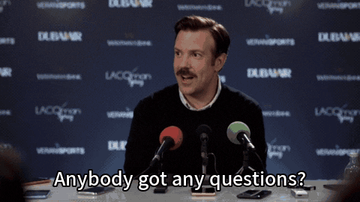
Thank you!
We are looking forward to a great year in Class 3!
Any Questions?

